Slide 1

Networking IoT

Slide 2
Content
Gateways and routing
Protocols and standards
IoT Connecting

Slide 3
Gateways and routing
Message in a network
https://courses.edx.org/courses/course-v1:CurtinX+IOT1x+2T2018/jump_to/block-v1:CurtinX+IOT1x+2T2018+type@vertical+block@e7e39fa900cd43998c170dfb091dd4c1

Slide 4
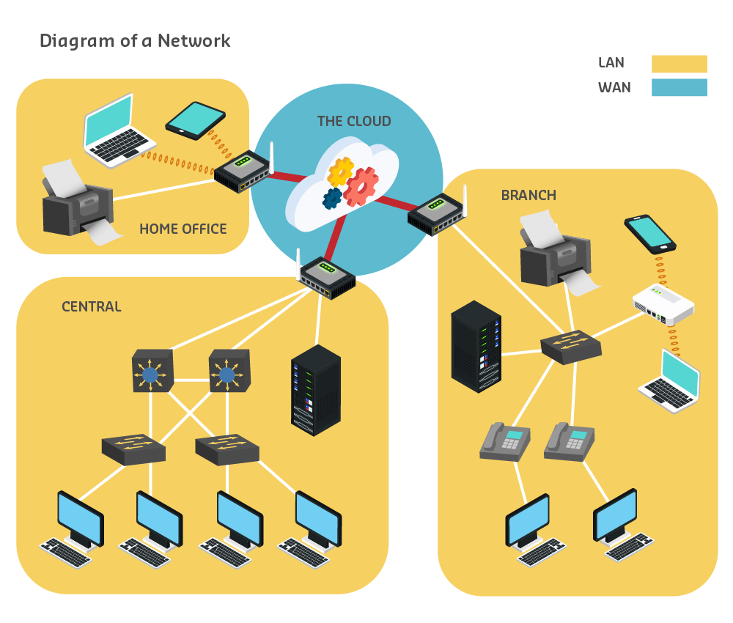
Note

Slide 5
Gateways and routing
Gateways and routing
https://courses.edx.org/courses/course-v1:CurtinX+IOT1x+2T2018/jump_to/block-v1:CurtinX+IOT1x+2T2018+type@vertical+block@68bee471065949faa0b825b4a6a2f3c2

Slide 6
Note
Communication in the network is carried through a medium – currently this means via either a cable (for example, metallic wires in copper cables, or glass or plastic fibres in fibre optic cables) or the air (wireless transmission).
The different media have different characteristics, which makes each better suited to different circumstances, taking into consideration factors such as:
the distance a signal needs to travel
the environment it is travelling in
the amount and speed of the data
the cost of the media and its installation.
The IoT adds even more circumstances and considerations for connectivity...making the ‘world wide web’ look more like a web than ever before.

Slide 7
Gateways and routing
Routing all the way
https://courses.edx.org/courses/course-v1:CurtinX+IOT1x+2T2018/jump_to/block-v1:CurtinX+IOT1x+2T2018+type@vertical+block@df6da06a5b9f415f8d25d4728a23f7f4

Slide 8
Note
Routing is the process of selecting a path for traffic in a network, or between or across multiple networks.
Broadly, routing is performed in many types of networks, including circuit-switched networks, such as the public switched telephone network (PSTN), and computer networks, such as the Internet.

Slide 9
Gateways and routing
Trace the route
https://courses.edx.org/courses/course-v1:CurtinX+IOT1x+2T2018/jump_to/block-v1:CurtinX+IOT1x+2T2018+type@vertical+block@31632f5897b246ec80b2939788ee0e63

Slide 10
Protocols and standards
Internet protocol (IP) addresses
https://courses.edx.org/courses/course-v1:CurtinX+IOT1x+2T2018/jump_to/block-v1:CurtinX+IOT1x+2T2018+type@vertical+block@40c2de5659f34eef829691e9f0ccbac2

Slide 11
Note
The addresses used to send data in networks are called Internet Protocol (IP) addresses. Ipv4 (version 4) is what is typically in use currently.
Ipv4 addresses consist of four sets of numbers separated by periods, and each number is between 0 - 255.
Ipv6 is being developed using six sets of numbers, colons and hexadecimal numbering to allow many more destination addresses. These will help to facilitate IoT, as well as adding features for improved routing, security and data flow.

Slide 12
Protocols and standards
Activity and Discussion: IP address lookup
https://courses.edx.org/courses/course-v1:CurtinX+IOT1x+2T2018/jump_to/block-v1:CurtinX+IOT1x+2T2018+type@vertical+block@7c991f21db174d1cb7a691e7adb7cd36

Slide 13
Protocols and standards
Domain Name Servers (DNS)
https://courses.edx.org/courses/course-v1:CurtinX+IOT1x+2T2018/jump_to/block-v1:CurtinX+IOT1x+2T2018+type@vertical+block@21ac54a76c0b4387877e2c3f0ca23b14

Slide 14
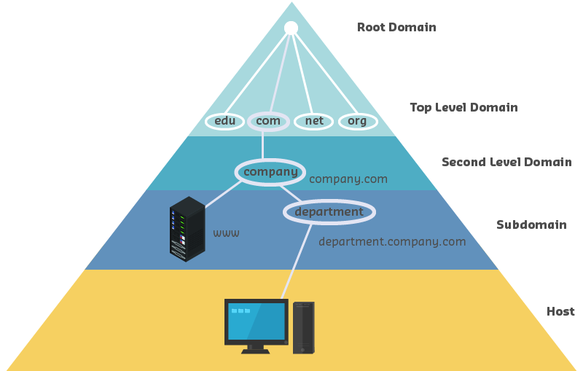
Note
The DNS is a large database of computer names and their internet addresses, but it is spread out so that no server has all the information.
If a computer requests a domain name and that server doesn’t have it, it forwards the request to another DNS server.
The Domain Name Service has a hierarchical structure, so requests get sent from the bottom up.

Slide 15
Protocols and standards
Playing at protocols
https://courses.edx.org/courses/course-v1:CurtinX+IOT1x+2T2018/jump_to/block-v1:CurtinX+IOT1x+2T2018+type@vertical+block@af88be0ca4214204b971f565a4419799

Slide 16
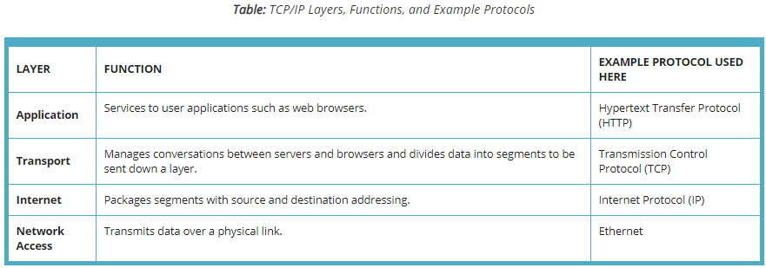
Note
A protocol is an agreed (or accepted) set of rules for a procedure.
TCP/IP: a set of rules that governs the connection of computer systems to the Internet.
Standards and protocols exist so that messages can get through and miscommunication is minimised.
It helps to remember that communication between machines and communication between people fit the same model.

Slide 17
IoT connecting
IoT connecting
https://courses.edx.org/courses/course-v1:CurtinX+IOT1x+2T2018/jump_to/block-v1:CurtinX+IOT1x+2T2018+type@vertical+block@08e137fe75d448a8abc9f4e8933e9900

Slide 18
Note
Connecting everyday things to the internet brings with it a host of different situations that are more varied and problematic than a computer at a desk, or even a smart phone on the move. To address these complexities, IoT solutions need to use various protocols, depending on the situation.
There are also newer protocols and connectivity types being developed specifically for IoT: LoRa, Sigfox, NB-IoT.

Slide 19
IoT connecting
Video: Case study: Networking devices
https://courses.edx.org/courses/course-v1:CurtinX+IOT1x+2T2018/jump_to/block-v1:CurtinX+IOT1x+2T2018+type@vertical+block@5bcd4b65bf5045ea88218201ddf430ea

Slide 20
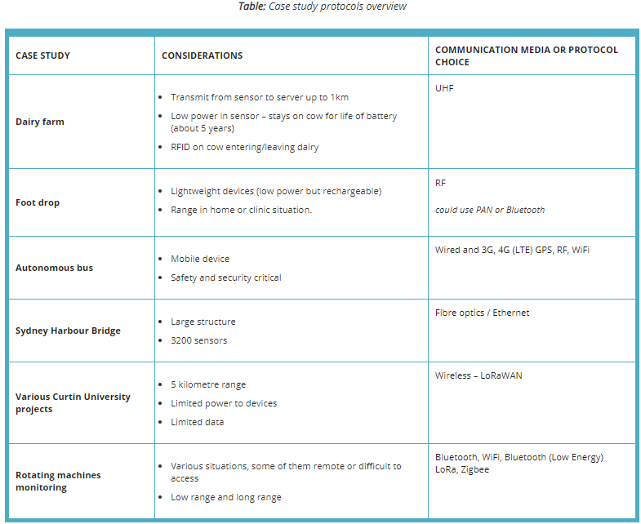
Note

